Slide 2
Evolution of blade cracks with wind turbine simulation tools
Maria Luz Castilla Mena (s212601@dtu.dk)
Notes:
Hi, I am Maria and I am going to present my master thesis topic: Evolution of blade cracks with wind turbine simulation tolos (this is a provisional titile, it needs to be discussed)

Slide 3
INDEX
Introduction to the topic
Purpose of the meeting
Results
Outcome of the meeting
For the next meeting
Notes:
First of all, I am going to introduce the topic and the context of my Project, then I will outline the purpose of this meeting and I will discuss the results obtained during these past weeks. Afterwards, I will state what I would like the outcome of the meeting to be, and finally I will suggest a couple of things I could continue working until the next meeting.

Slide 4
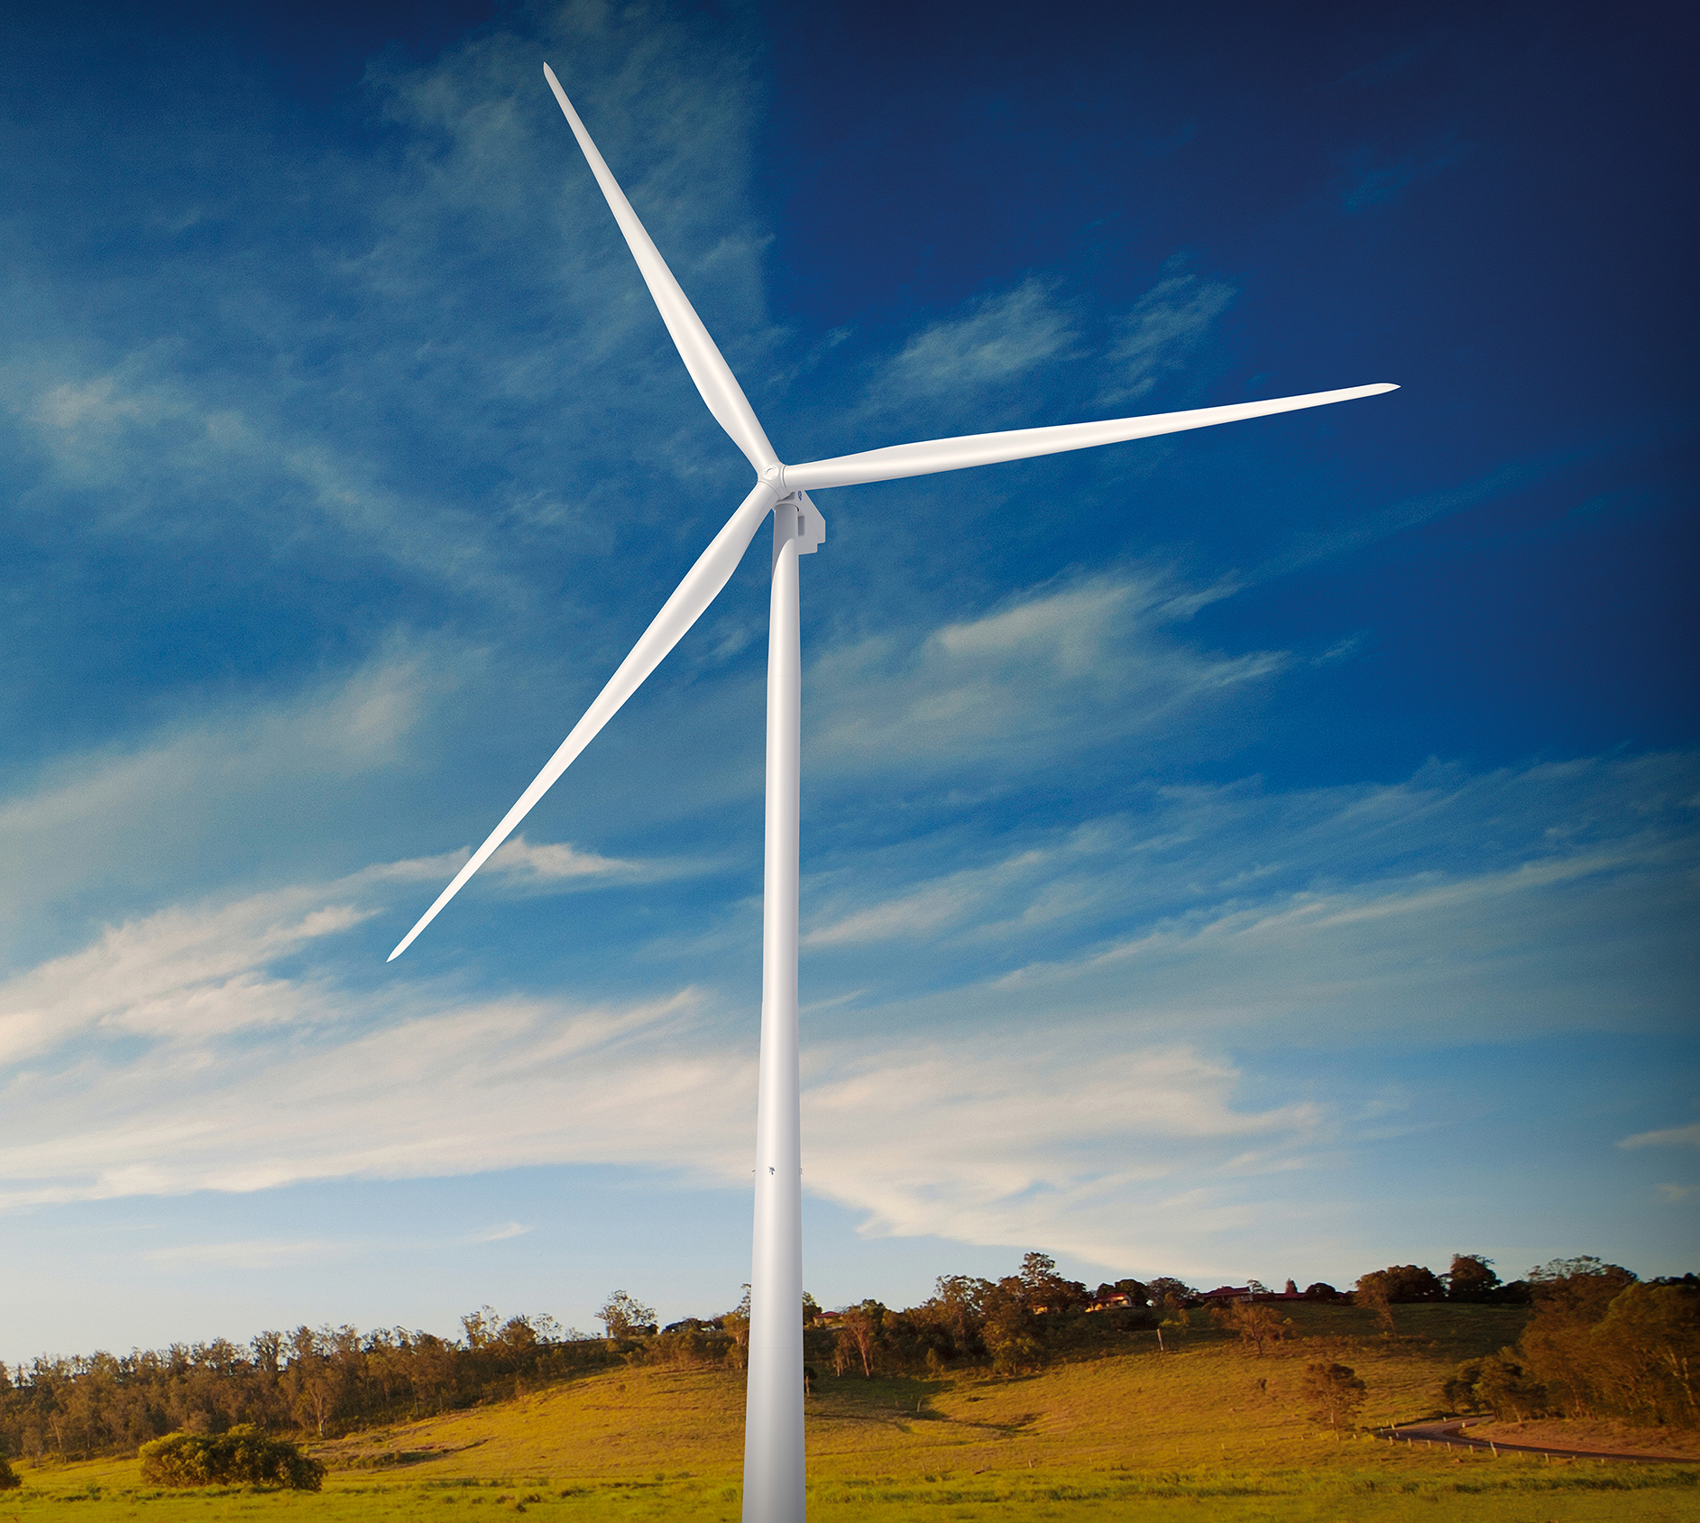
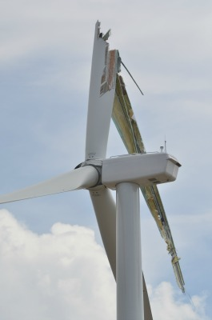
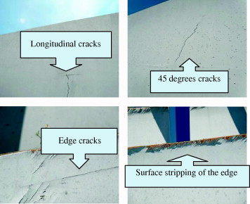
Introduction to the topic
Weak section
Vo
Notes:
Wind turbines are exposed to external conditions that can deteriorate its performance. In the aeroelastic context of a wind turbine, both the aerodynamic forces and the structural flexibility influence each other. The aerodynamic forces can make the blades suffer deformations and fractures may occur, and these deformations change the aerodynamic forces.

Slide 5
Problem approach
HAWC2
Abaqus
MATLAB
Notes:
3 softwares will be used to study the evolution of cracks that may appear in the blades due to the change in aerodynamic forces. Using the HAWC2 software, an aeroelastic wind turbine simulation tool, the aerodynamic forces are calculated and will be used in the ABAQUS software to calculate the deformation of the material and the new stiffness components, which will be needed again in the HAWC2 software to update the aerodynamic forces. Both softwares communicate with each other through MATLAB. A time simulation will be carried out using simultaneously the 3 softwares to study the evolution of cracks in the blades under certain external conditions.

Slide 6
Purpose of the meeting

Slide 7
Purpose of the meeting
HAWC2
Abaqus
Get started with the HAWC2 – MATLAB interface:
Download HAWC2 and MATLAB code
Run small cases
Understand physical process, workflow
Understand definition of parameters and variables, and the data structure
Overall status:
HAWC2 – MATLAB Interface
MATLAB

Slide 8
Results

Slide 9
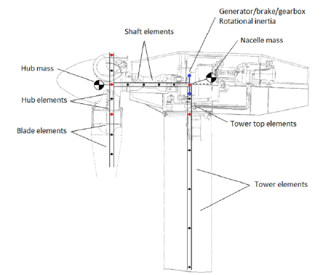
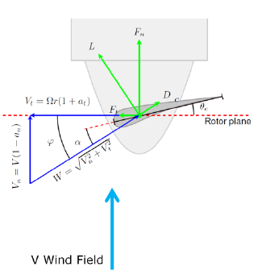
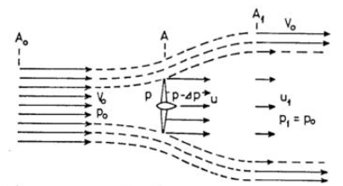
How HAWC2 is modelled
Structural Model
Aerodynamic forces on 2D airfoil
Aerodynamic Model
BEM formulation
DTU Wind Energy, Technical University of Denmark
Notes:
At the left, you can see the aerodynamic models HAWC2 is based on. It is based in the BEM formulation, which takes into account that the rotor slows down the air (induction factor a), and a model that describes the aerodynamic forces on the 2D airfoil sections of each blade element. These are interconnected, since to calculate the 2D aerodynamic forces you need to know the Flow seen by the airfoil, and that depends on the wind field, the motion of the structure, and the induction effects of the rotor aerodynamics. And the induction effects also depend on the aerodynamic forces acting on the rotor área.
At the rigth you can see a graphical representation of how the structure of a wind turbine is modelled in HAWC2. Beams are one dimensional: just length.
Tower, shaft, hub, blade: single main body
Nacelle, hub: point mass
It is a simple representation but being the beam properties well defined, the dynamics are accurate and useful for load analysis.

Slide 10
Workflow HAWC2
Input files
Main input file: .htc file
Data input file: .
Aerodynamic Model: .ae, .pc
Structural Model: .st
Control DLL files
Output files:
Time simulation output file (\res folder): .dat, .sel
Log file: .log
Notes:
In order to get HAWC2 to work, some input files are needed. We need .htc file, which is the main input file with the global definition of the structure (location of nodes, number of bodies, orientation of the coordinate systems). Then we need the data input files. To start with, I focused on the aerodynamics and structure files. For the aerodynamic model we need files ended in .ae (defines the aerodynamic layout of the Blade as a function of the radial position (chord, thickness)) and in .pc (file that contains coefficients such as lift, drag and moment coefficients as function of the angle of attack).
We also need the structural model, files ending with .st, which contain the cross-sectional properties for the Timoshenko beams (mass, inertia, stiffness…)
.ae: Aerodynamic blade layout file (Radius (m), chord(m), thick(%), PC)
.pc: Profile coefficients
DLL: Dynamically linked libraries for Windows computers. There are compiled programs

Slide 11
Workflow main input file: .htc
.htc file:
Begin simulation (Newmark method)
Begin new_htc_structure
Begin main body: tower, towertop, shaft, hubs (1,2,3), blades (1,2,3),
Modeled as Timoshenko beams
Begin orientation
Begin constraint
Begin wind
Begin mann, tower shadow potential
Notes:
The main .htc file is divided in blocks in which different characteristics are defined. As mentioned before, I will focus more for now in the structural and aerodynamic blocks.
Simulation block: global simulation parameters are defined
New htc structure block: the entire structure is specified
Main body block: configuration of all the main bodies. It defines a structural component

Slide 12
Workflow main input file: .htc
Begin aerodrag
Begin aero
Begin dll
Begin output

Slide 13
Workflow Matlab
Main.m:
Run hawc2mb.exe and .htc file
Call HAWC2matlabScript.m
Convert data from HAWC2 to Matlab through strings/arrays
ReadHawc2.m function? When to use it?

Slide 14
Time simulations: 600s, 1s, 0.1s
Purpose 600s: Check the overall output of the whole simulation and discuss the results obtained
.sel & .res files obtained aprox. in 1-2 h
Matlab code never ends – stuck in while loop?
Purpose 1s: Relatively quick check to see if everything works as it should
-sel & .res files obtained aprox. in 15 min
Matlab code never ends
Purpose 0.1s: Debug code to look for the errors
-sel & .res files obtained instantaneously
Matlab code never ends – it gets stuck in while loop

Slide 15
Outcome of the meeting

Slide 16
Outcome of the meeting
Discussion of understood concepts and results obtained
Discussion of the general context of the problem
Why doing this approach?
Advantages of using this approach for real life wind turbines vs. other current approaches
Other topics
Discussion contents problem registration document (title, explanation/content)

Slide 17
For next meeting…

Slide 18
For the next meeting
Solve MATLAB problems: Meeting with Ximi
Matlab code never finishes running
Gets stuck in a while loop (time simulation = 0.1s)
Other errors (time simulation = 1s): “An existing connection has been forcibly broken by the remote host”
Log file errors: “ *** WARNING *** Symbol not found in dll: message”
Next meeting?

